Slide 1
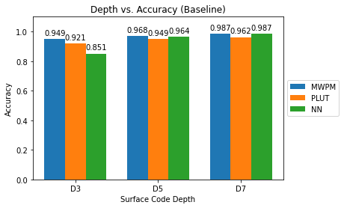
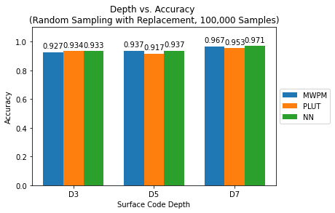
UNCLASSIFIED
Evaluating Neural Network Decoder Performance for Quantum
Error Correction Using Various Data Generation Models
Research Topic
Student: 2d Lt Brett Martin
Advisor: Dr. Laurence D. Merkle
Objective
Create exhaustive data sets for use in training, testing, and validating neural network models for the purpose of low-level quantum error correction decoding.
Evaluate the effect of data set generation technique on the effectiveness and efficiency of low-level neural network decoders for quantum error correction.
Methodology:
Construct high-performance computing algorithms to generate exhaustive training data sets.
Train and test neural network models using these sets.
Evaluate performance of neural network decoders against each other and baseline values from past work.
Decoder accuracy for baseline neural network decoders versus the neural network model trained using randomly-sampled data sets containing 100,000 samples.
Current Status
Research Progress
Created exhaustive and randomly-generated data sets with varying sizes up to 500,000 samples and varying combinatorics for surface code depths 3, 5, and 7.
Trained and validated neural network models based on baseline models created in previous research, and evaluated all models on various performance metrics including accuracy, precision matrix, and F1 score.
Compared all neural network models in a dynamic surface code simulation which compared performance of all decoders based on error correction cycle count.
Proved that data set size and generation technique has an effect on the overall performance of the neural network decoder.
Future Work
Considerations going forward
Generating exhaustive data sets is computationally expensive, random sampling can be optimized instead.
Without the assumption that each qubit is equally likely to have an error, random sampling is also too expensive.
Future Research
High performance computing algorithms can be optimized to generate larger data sets without exceeding hardware limits.
Evaluation of these neural networks against other decoding algorithms, including Blossom and distributed models.
Impact
Insight into the qualities of a data set that are morel likely to increase the effectiveness and efficiency of a fast means of quantum error correction, which is necessary for large-scale quantum processors.
UNCLASSIFIED
1
Notes:
1

